Slide 1
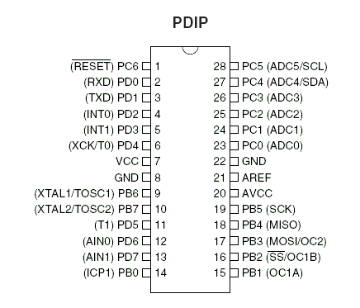
External Interrupts

Slide 2


Registers

Slide 3



Registers

